Slide 1
Ground-Water Quality Monitoring System
Date: 26-02-2025
Presented by:
Hadiya Sajjad, Zahra Mahzooni, Khalid Mohammed, Jeremiah Pulickal, Mohamed Elgamal, Mohammed Ali, Ibrahim Ismail

Slide 2
Presentation Outline
Introduction
Project Scope
Background / Existing Solutions
Methodology
Outcomes / Deliverables / Results & Discussion
Challenges Encountered & Resolution
Conclusions & Future Work
Gantt Chart
References
Q&A

Slide 3
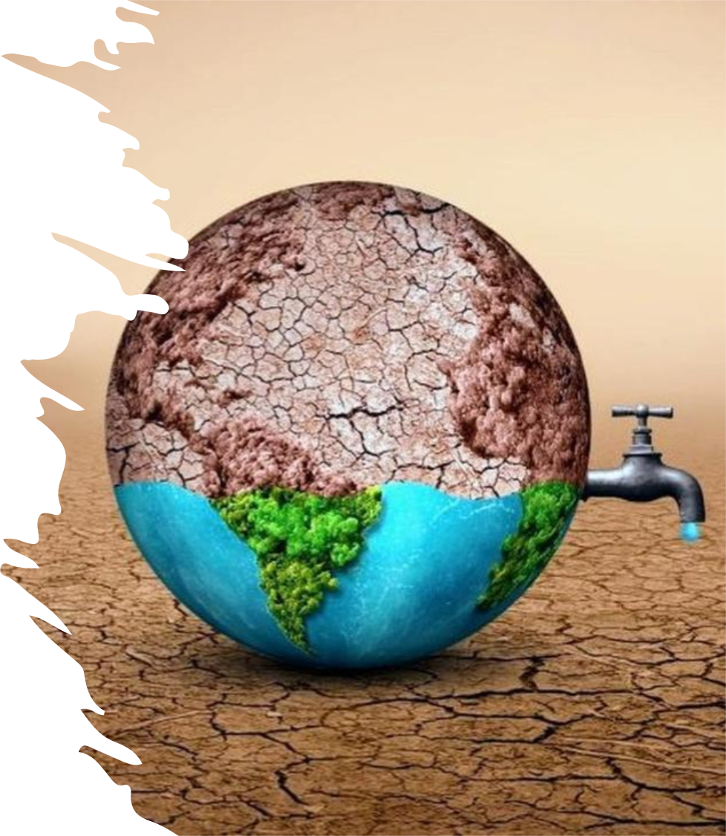
Why Monitor Groundwater?
Water is essential for life, playing a crucial role in health, agriculture, and industry.
Qatar relies heavily on groundwater and desalination due to its arid climate.
Water pollution poses risks to health and the environment.
Sources of contamination include agricultural runoff, industrial waste, untreated sewage, and potential salinity intrusion, threatening this vital resource.
Nearly 2 billion people lack access to safe drinking water, highlighting the universal importance of water quality.

Slide 4
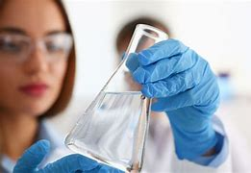
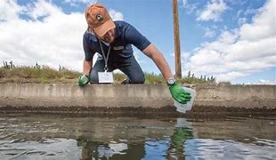
Bridging the Gap with Technology
Traditional monitoring methods often involve delays (manual sampling, lab testing), making them reactive rather than proactive.
Our project focuses on using an IoT sensor network to provide a real-time groundwater level and quality monitoring dashboard.
This approach aims to deliver continuous data and instant insights, enabling faster responses to potential contamination events.

Slide 5
Project Scope & Objectives
Problem Addressed: The absence of an efficient, continuous monitoring framework for groundwater in Qatar.
Our Solution: A real-time IoT-based groundwater level and quality monitoring system.
Key Parameters Monitored: pH, Turbidity, Temperature, Total Dissolved Solids (TDS), Oxidation-Reduction Potential (ORP), Water Level.
Main Objectives:
Develop and deploy the real-time IoT monitoring framework.
Design a comprehensive dashboard for real-time and historical data visualization.
Implement an automated alert system for anomalies.
Improve water resource management efficiency and cost-effectiveness.
Enhance public health protection via early detection.

Slide 6
Limitations of Traditional Monitoring
Current methods in Qatar primarily rely on periodic manual sampling and laboratory analysis (Ref: Al-Mashaqbeh et al., 2019, if applicable).
Key Limitations:
Slow & Reactive: Significant delays between sampling, analysis, and action.
Resource-Intensive: Costly in terms of labor and lab facilities.
Infrequent: Contamination events occurring between sampling intervals may be missed.
Lack of Real-time Alerts: Inability to provide immediate warnings for sudden changes.
These limitations hinder effective and proactive groundwater management, highlighting the need for advanced solutions like IoT.

Slide 7
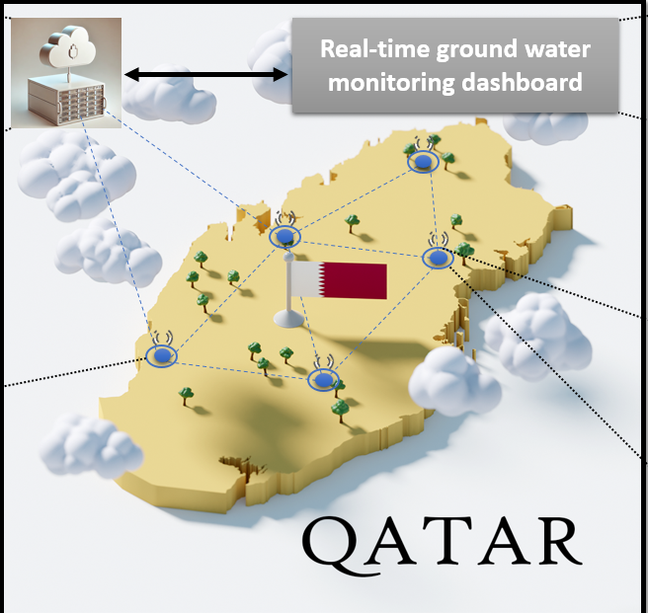
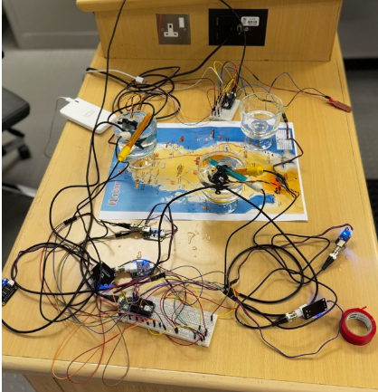
System Architecture
Content:
Our system integrates sensors with a microcontroller,
transmitting data wirelessly to a cloud platform for storage,
analysis, and visualization.Flow:
Sensors measure water parameters.
Arduino MKR WiFi 1010 collects and processes sensor data.
Data transmitted via Wi-Fi as JSON payload.
Node.js server listens, validates, and reformats data.
Data stored in MongoDB Atlas cloud database.
Python-based dashboard retrieves data for visualization and alerting.

Slide 8
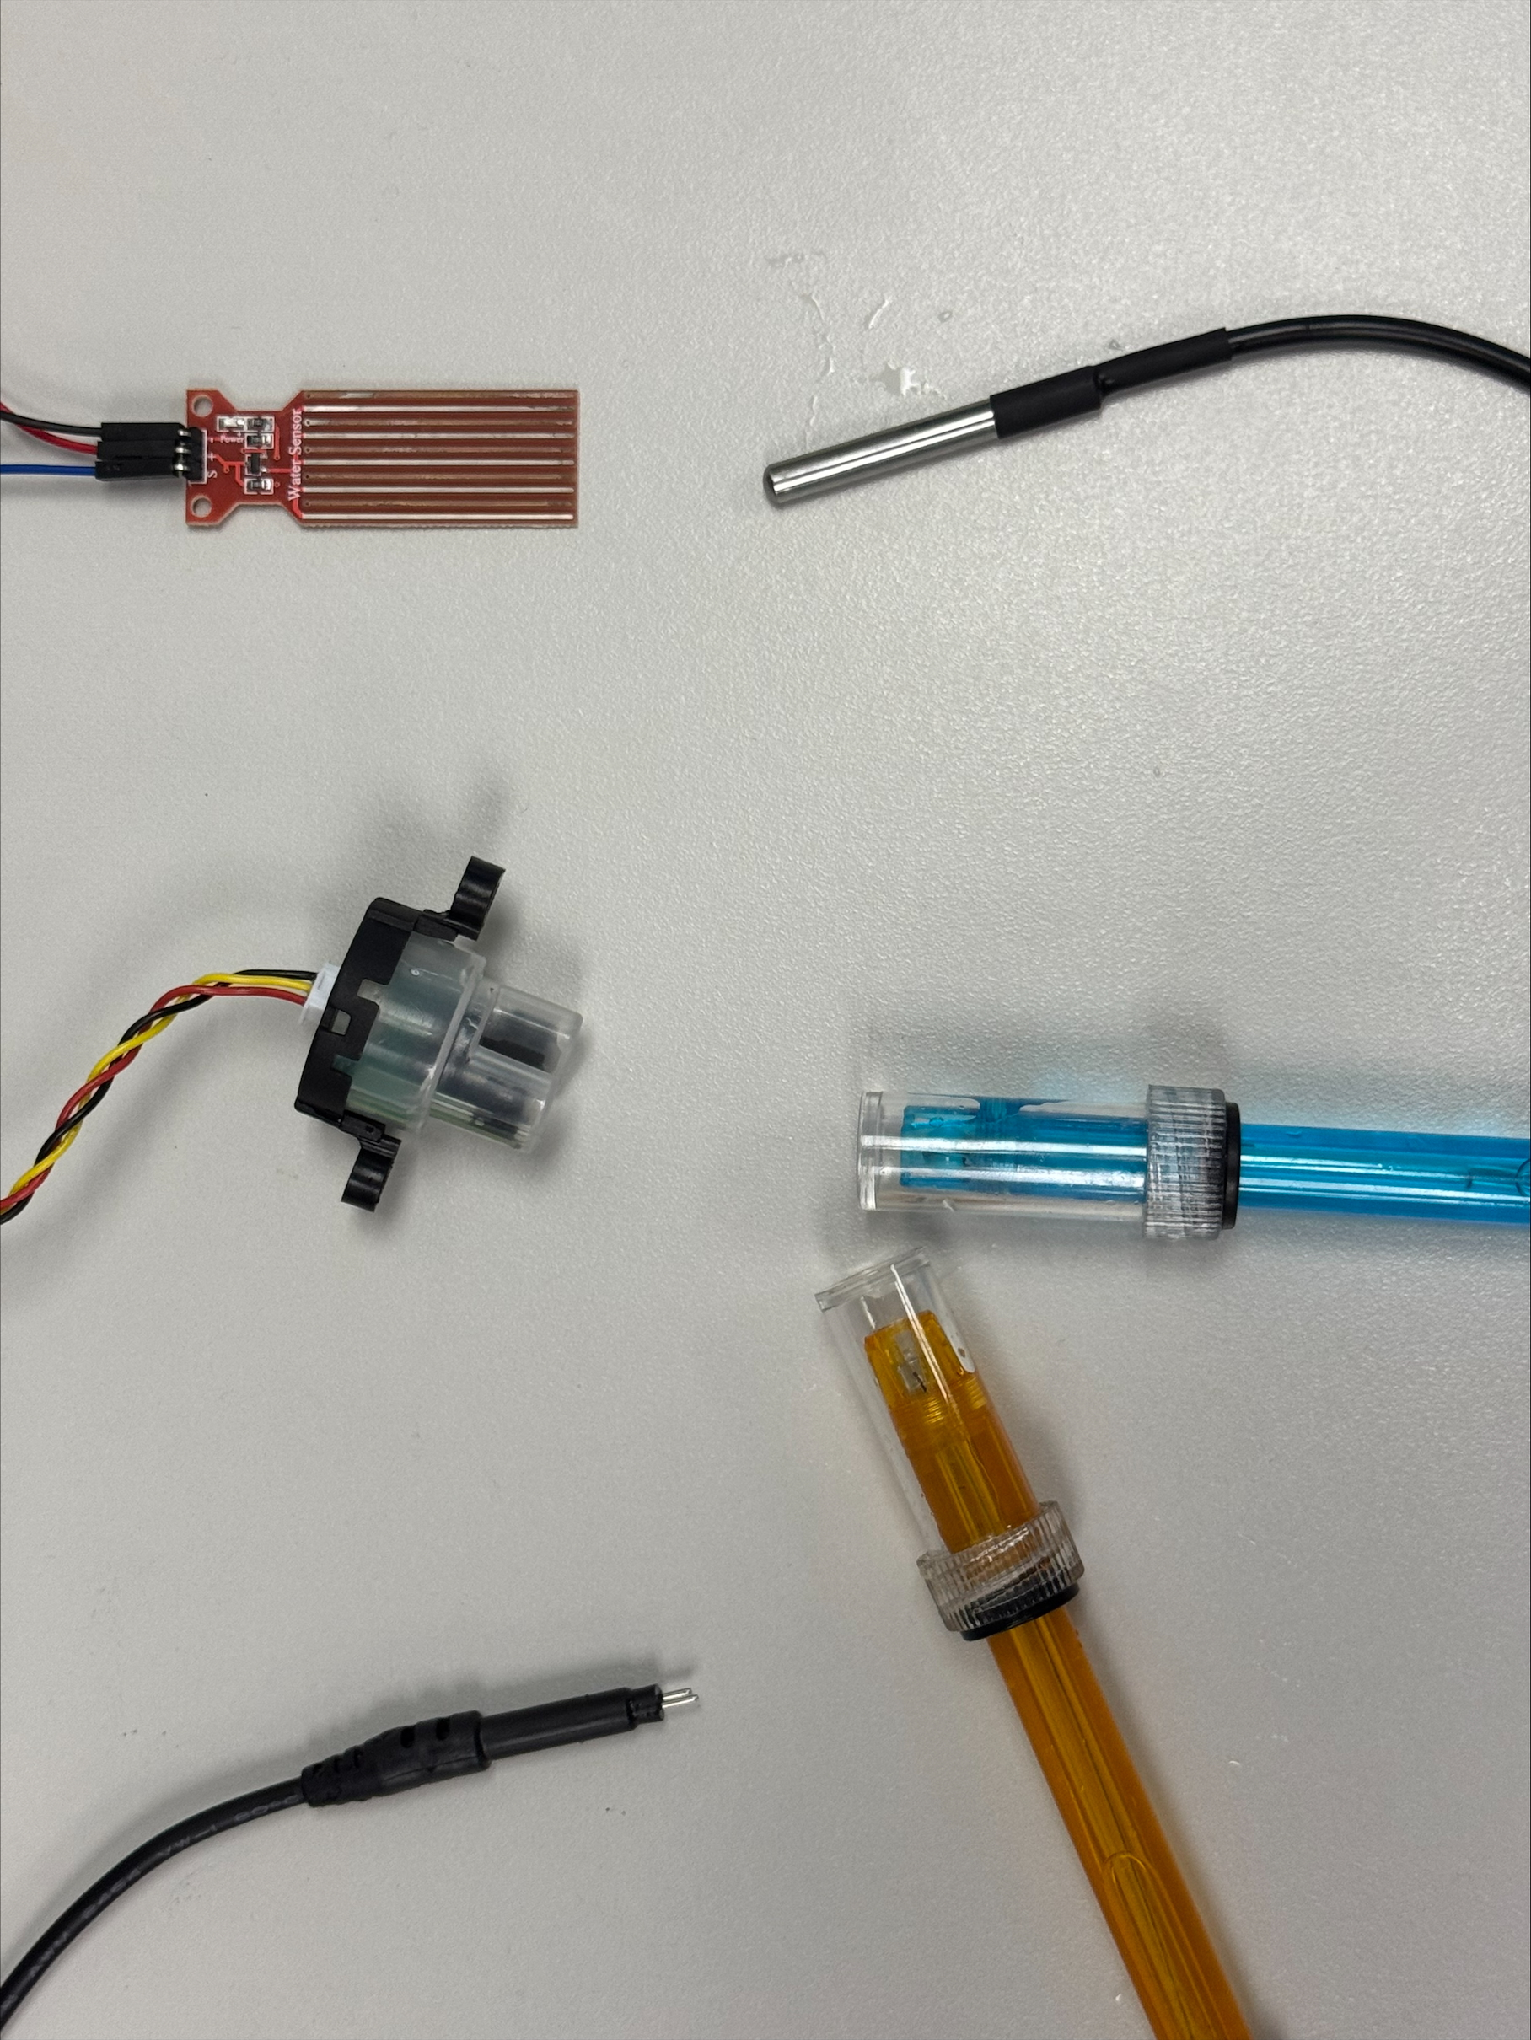
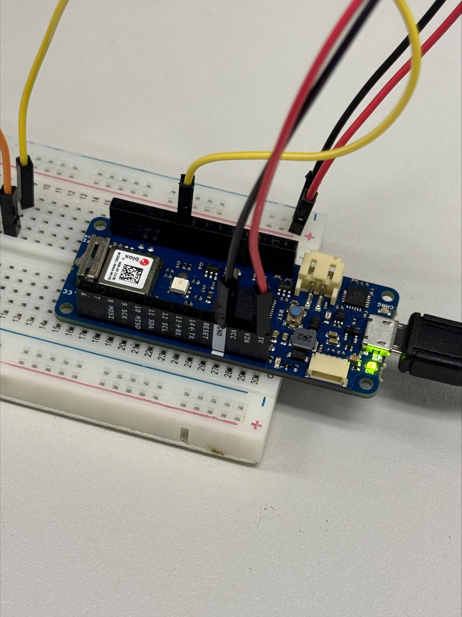
Hardware Components
Content:
Microcontroller: Arduino MKR WiFi 1010 (chosen for built-in Wi-Fi connectivity and processing power).
Sensors Deployed
pH Sensor
Turbidity Sensor
Temperature Sensor (often integrated)
Total Dissolved Solids (TDS) Sensor
Oxidation-Reduction Potential (ORP) Sensor
Water Level Sensor (e.g., ultrasonic or pressure-based)
Sensor selection emphasized accuracy, compatibility, and reliability. Careful calibration was performed.

Slide 9
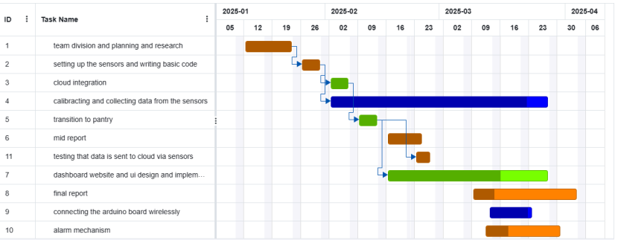
Project Timeline (Gantt Chart)
Content:
This Gantt chart illustrates the project's timeline, key phases, task dependencies, and overall management from initiation to completion.

Slide 10

Methodology
Phase 1: Sensor Connection and Data Collection
Phase 2: Cloud Integration
Phase 3: Single Sensor Testing and Calibration
Phase 4: Dashboard Development
Phase 5: Multi-Sensor Expansion
Phase 6: Alert system Design

Slide 11
Data Acquisition, Transmission & Storage
Content:
Acquisition: Sensors read data continuously (configured for readings every 1 second).
Transmission: Arduino formats data into a JSON object including sensor values and device ID. Transmitted securely over Wi-Fi to the server endpoint.
Server Processing: A Node.js application running on a server listens for incoming data, validates it, adds a timestamp, and reformats it for database insertion.
Storage: MongoDB Atlas (a cloud NoSQL database) is used.
Main collection: sensor data stores all readings.
Separate collections (e.g., location0, location1) store data for specific sites for historical analysis.
Database indexed on timestamp and location for efficient querying.

Slide 12
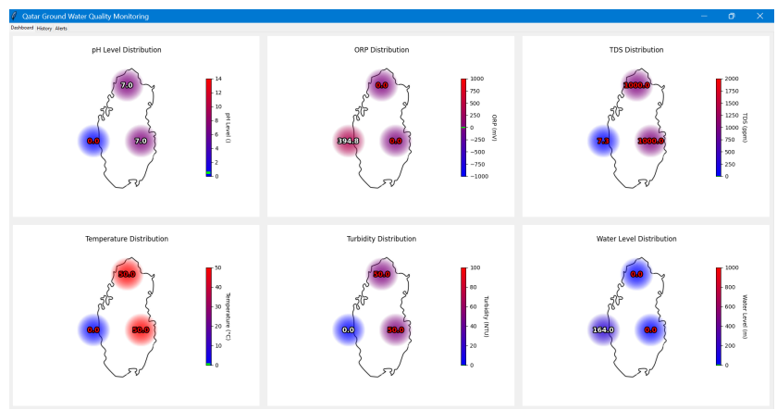
Data Visualization Dashboard
Content:
Technology: Developed using Python with Tkinter for the GUI, and Matplotlib/Seaborn libraries for plotting.
Functionality: Provides stakeholders with access to both real-time and historical data.
Visualizations:
Live readings for each parameter.
Historical trends (Line graphs, Bar charts).
Spatial distribution (Color-coded Heatmaps on a map of Qatar).
Designed for clarity, ease of interpretation,
and quick identification of anomalies.

Slide 13
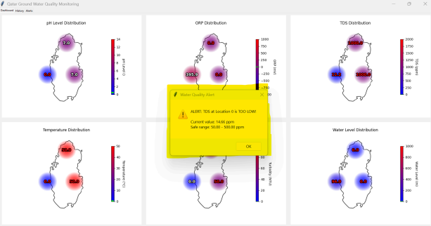
Alert System & Validation
Content:
Alert System:
Compares incoming sensor data against predefined thresholds (Normal, Minor/Major Deviation - show table from Report p12).
Triggers real-time alerts for out-of-range values.
Alerts displayed as pop-ups on the dashboard and logged with severity (Minor, Average, Major).
Dedicated 'History' tab shows log of past alerts.
Testing & Validation
Sensors tested with various water samples for functionality.
Accuracy validated using samples with known values
obtained from UDST College of Engineering.
Due to access constraints, testing was conducted in a
controlled lab environment simulating relevant conditions.

Slide 14
Project Outcomes & Deliverables
Content:
Outcome 1: Functional IoT Monitoring System: Successfully developed and deployed the system capable of continuously tracking key groundwater parameters in real-time.
Outcome 2: Intuitive Data Visualization Dashboard: Implemented a user-friendly dashboard providing clear visualizations of live and historical data trends and spatial distributions.
Outcome 3: Automated Alert System: Established an effective alert mechanism that notifies stakeholders immediately of deviations from safe water quality standards.

Slide 15
Results & Discussion
Content:
The system provides continuous data streams, unlike traditional periodic sampling, allowing for immediate detection of changes.
Visualizations (heatmaps, graphs) effectively highlight trends, potential contamination patterns, and parameter fluctuations across time and locations.
The alert system proved effective in flagging anomalies based on predefined thresholds, enabling timely intervention possibilities.
Impact: This demonstrates a significant improvement in efficiency and potential cost savings over manual methods. It shifts groundwater management from reactive to proactive.
The collected data forms a valuable baseline for future analysis and trend prediction.

Slide 16
System Demonstration

Slide 17
Challenges & Resolutions
Content:
Challenge: Initial Sensor Availability & pH Sensor Malfunction.
Resolution: Extensive vendor search (Voltaat partnership), support from project supervisor/IT dept for replacement (though delayed).
Challenge: Platform Instability (Arduino IoT Cloud data loss).
Resolution: Implemented robust local backup strategy for configurations and shifted visualization to Python locally.
Challenge: Sensor Calibration & Data Accuracy (esp. pH).
Resolution: Followed datasheets, conducted controlled experiments, validated against known standards. Acknowledged limitations with final pH accuracy.
Challenge: Accessing Real Groundwater Wells.
Resolution: Conducted all testing in a controlled lab environment using simulated conditions.

Slide 18
Conclusions
Content:
This project successfully demonstrated the feasibility and effectiveness of an IoT-based system for continuous, real-time groundwater monitoring in the context of Qatar.
The system addresses key limitations of traditional methods by providing timely data, intuitive visualizations, and automated alerts.
Key contributions include the fully functional monitoring framework, the user-friendly dashboard, and the integrated alert system.
This work provides a foundation for more proactive, efficient, and data-driven groundwater resource management.

Slide 19
Future Work & Recommendations
Content:
Expand Sensor Network: Deploy sensors at multiple strategic locations across Qatar for comprehensive coverage.
Enhance Predictive Analytics: Implement machine learning algorithms to forecast water quality trends and predict potential contamination events.
Integrate with Existing Systems: Connect the IoT platform with national water management infrastructure for automated control and optimization.
Develop Mobile Application: Create mobile apps for stakeholders to access real-time data and receive alerts conveniently on smartphones/tablets.

Slide 20
Acknowledgement
The project team would like to express sincere gratitude to the faculty and staff of the collage of Computing and Information Technology at UDST for their continuous support, guidance, and valuable feedback throughout the development of this graduation project. Special thanks to our project supervisor, Mr. Ala Gouissem, for his expert advice and encouragement at every stage.

Slide 21
Key References
Content:
Arduino. (n.d.). Arduino MKR WiFi 1010.
Python Software Foundation. (n.d.). Python. & Relevant Libraries (Tkinter, Matplotlib, Seaborn).
World Health Organization (WHO). (2023). Drinking-water.
Planning and Statistics Authority - Qatar. (2022). Qatar National Vision 2030.
MongoDB. (n.d.). What is MongoDB?
(Note: A full list is available in the project report.)

Slide 22
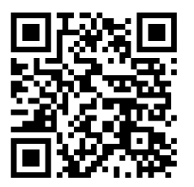
Code Availability & Demo
Content:
Full source code and sample data available on GitHub:
[Link: https://github.com/Mohamed-Elgamal-25/GroundwaterSystem.git]

Slide 23
Thank You & Questions

